Slide 1
AI Enabled New Products from Captured Carbon
Solving the most Sirius Challenges in Climate Tech with AI/ML | Seed deck
sirius.bio

Slide 2
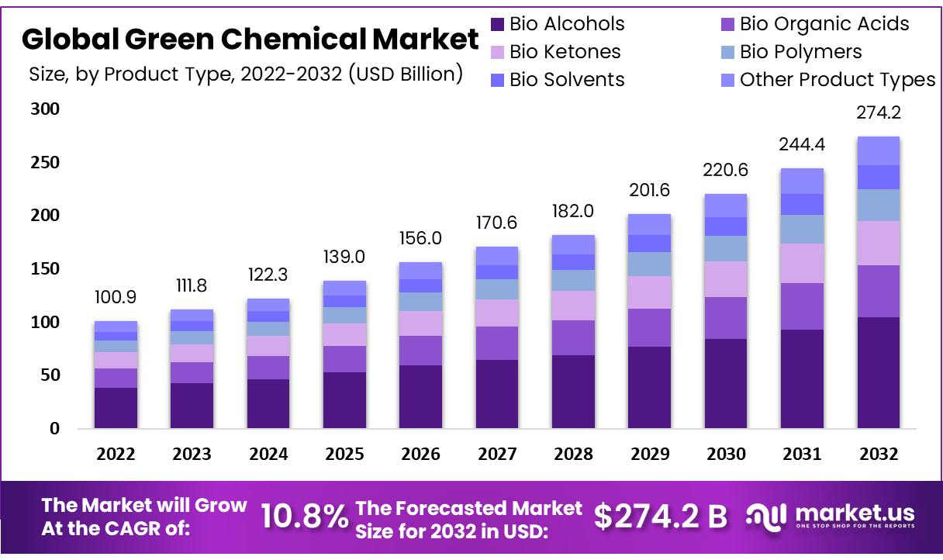
Green Chemicals Market to Hit 274.2B$ by 2032
OPPORTUNITY
Strong market
10.8% CAGR
But….
Bioproduction companies struggle: Amyris, Solazyme, Zymergen…
Why?

Slide 3
PROBLEM
BIOTECHNOLOGY IS SAID TO OFFER CARBON NEUTRAL/NEGATIVE
FOODS, MATERIALS, MEDICINES, & CHEMICALS, BUT:
💵 LIMITED TO MODEL MICROBES
Commonly used expression models such as ecoli, saccharomyces and other bacterial and yeast are limited to certain feedstocks .
High Cost (OPEX)
High Carbon Footprint
Unsustainable
Unoptimized
Underperforming
🛠️ ADDICTED TO SUGAR
Most bioproduction utilizes sugar, corn, oil seeds or other crops as feedstocks and thus inherits their cost and carbon footprint. 10s of millions wasted trying to adapt model microbes to hydrogen, CO2 or methane.
⌛️ SLOW AND ARTISANAL DEVELOPMENT
Time and cost of bioengineering is high and pressure to scale leads to unoptimized production systems

Slide 4
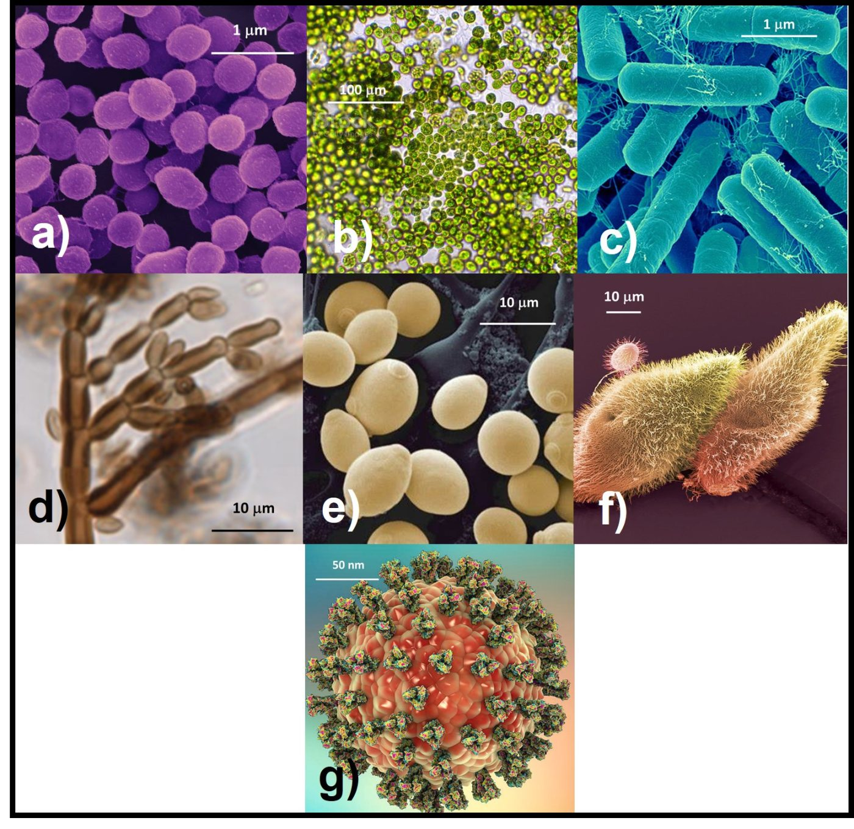
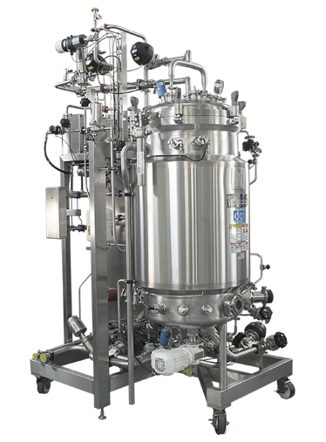
Waste Carbon is the cheapest and most abundant feedstock
Foods
Chemicals
Materials
Medicines
But to unlock its value we need new model organisms and better bioengineering
PROBLEM
Methane (CH4)
Over 135 MT emitted each year
Carbon Dioxide (CO2)
Over 36.8 BT emitted each year
Plastic Waste
Over 400 MT produced each year
MSW
Over 2 BT produced each year

Slide 5
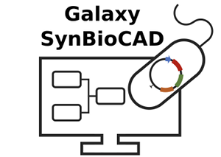
Sirius Solution: Build on Existing AI/ML Platform
Use our proven AI/ML Bioengineering pipeline to:
Create new model organisms that unlock C1 and other waste carbon feedstocks
Reduce the number of experiments required to create optimized strains by >50X
Save customers time, money, headcount while delivering optimized solutions that enable profitability at scale
Our SynBioCAD and Hybrid AI/ML infrastructure is the product 22 FTE/yrs of work and >10M€ invested in academic science
SIRIUS SOLUTION

Slide 6
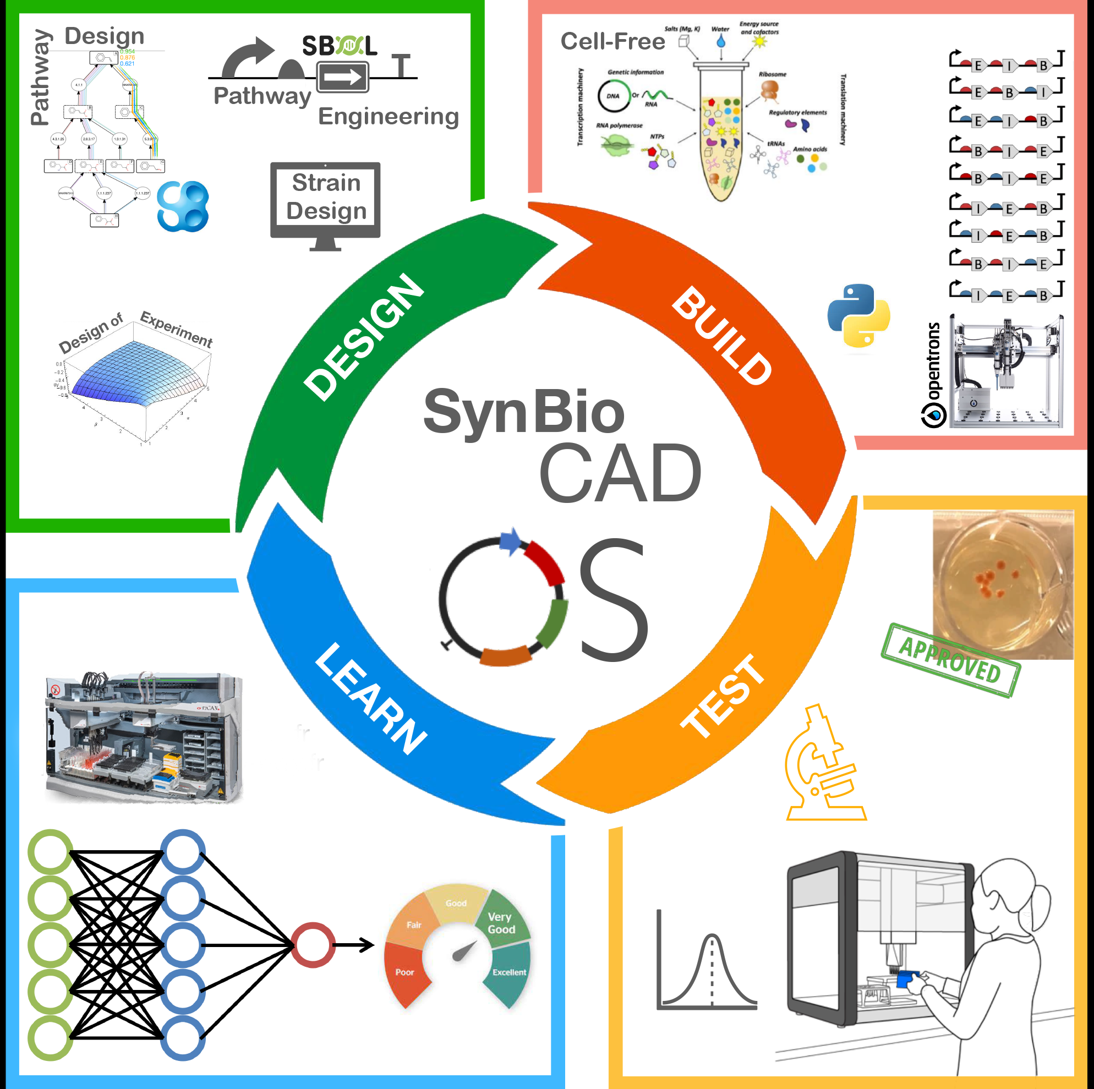
Benefits of Sirius Solution and Use Cases
USE CASES
Create better systems via AI /ML driven DBTL cycle for bioengineering and outcome optimization.
Proven cutting edge AI/ML technology for:
Bioproduction: Produce Target Chemical of Choice
Biodegradation: Degrade Chemicals
Biotransformation: Transform ‘Bad’ Chemicals to ‘Good’ Chemicals
Media Optimization: Improve Process Titer, Rate and Yield
Microbial and cell-free systems
50X
required workflows reduction
34X
target production increase

Slide 7
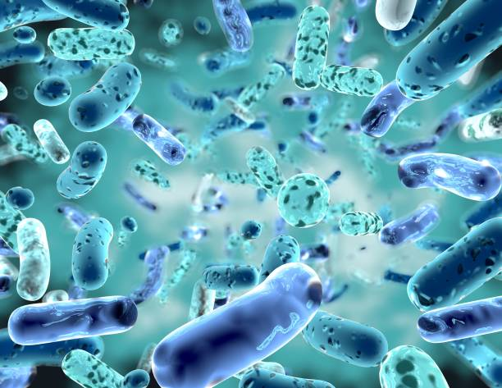
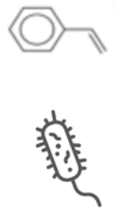
DBTL Pipeline
Improve strains with Hybrid ML/AI:
Neural Mechanistic Modeling (NMM) and Active Learning
New Model Organism
Create chassis microbe
ie: Optimized for CH4
Bioinformatic/Literature
Using bioinformatic sources we have built a library of known Methanotrophs and Hydrogenotrophs SBML/computational Models
Learn and model
Sequence organisms and identify key enzymes.
Make SBML/computational Models which are used to construct NMM. Each iteration builds ML training set with active learning
Design
AI/ML Pipeline uses Using AMN in a hybrid active learning system to create Design of Experiments and procedure set
New Enzyme
For use as biocatalyst
As a target for improved function/utility
DBTL
CYCLE
Test
High throughput systems to determine best conditions/performance. AI/ML to optimize media, conditions and systems, -omics to determine capabilities and GOIs
Bioprospect
Collect samples from best environments with gas systems from start
Screen
Test isolates for growth characteristics. Send for 16s strain identification
Build
High Throughput, automated system, creates variants following DOE
Optimized
Process
Improved Titer, Rate, Yield
In our Neural Mechanistic Model (NMM) approach creates a neural network which contains the strain metabolic network. Peer reviewed paper on NMM by Sirius Co-Founder Jean-Loup Faulon PhD. https://doi.org/10.1038/s41467-023-40380-0

Slide 8
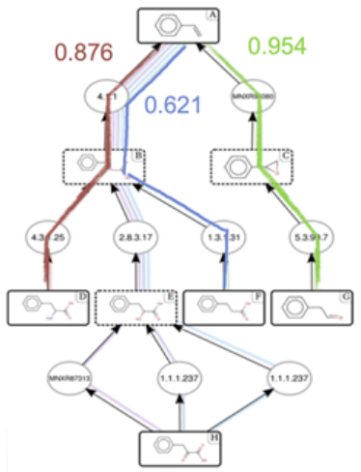
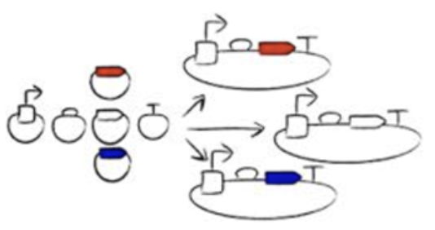
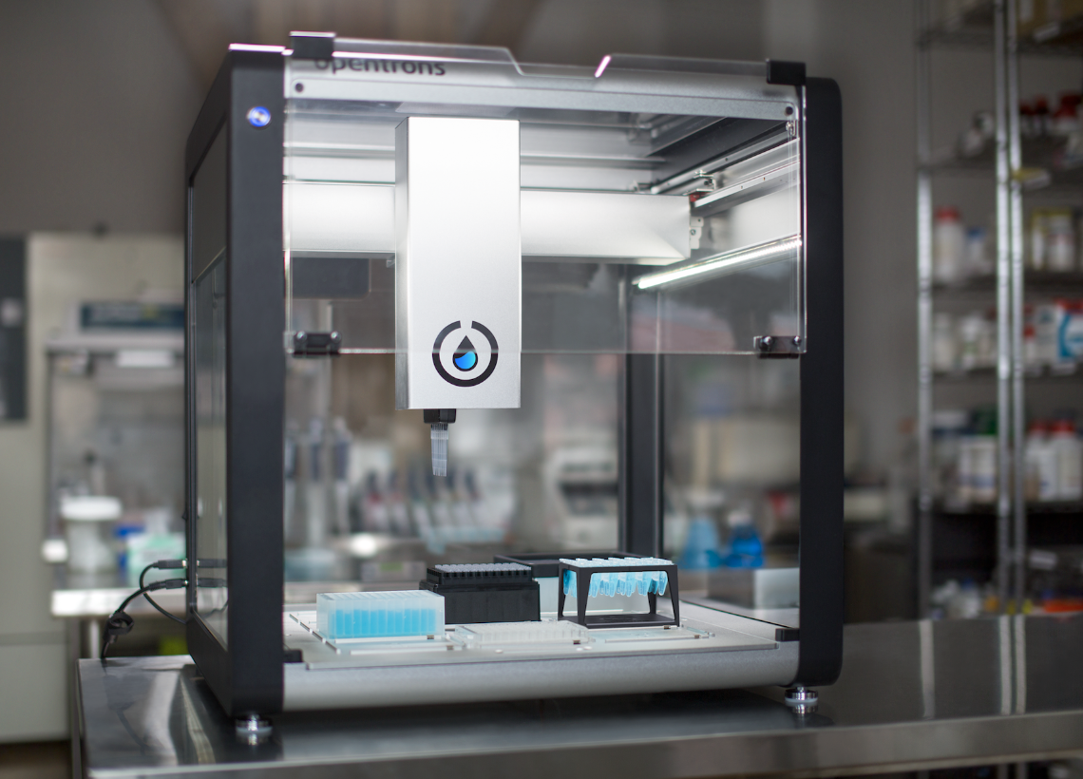
SynBioCAD AUTOMATION
SYNBIOCAD: AN AUTOMATION AI/ML SOFTWARE TO
SIMPLIFY, AUTOMATE, AND ACCELERATE SYNBIO DESIGN & ENGINEERING
*COMMERCIAL FORK OF SYNBIOCAD OPENSOURCE, CREATED BY OUR CTO
INPUT
Your target molecule
and host organism
RETROSYNTHESIS
We construct & rank the metabolic pathways
to produce the target
GENETIC DESIGN
We assemble the
genetic parts to build
the selected pathway
OUTPUT
Automatically get the scripts to automate the robotics & building part
We use active learning (ML) and AI to create superior Design of Experiments which reduces the number of required steps for creating optimized solutions. We deploy this on our existing SynBioCad framework. Peer reviewed paper on SynBioCad by CTO and co-founder Joan Hérisson PhD. https://www.nature.com/articles/s41467-022-32661-x

Slide 9
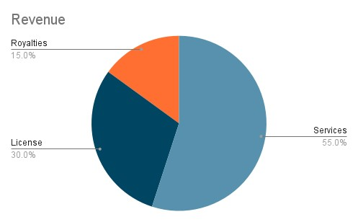
Business Model
Business Model
Engage with Customers With CDMO Model
Develop New Models for Waste Carbon
Engineer Commercial
Strains
Spin Out
License
Join Venture
Improve Customer
Strains and Process
CDMO
Earn Revenue From Mix of Service, License and Royalties

Slide 10
COSTS & PRICING
WE SAVE CUSTOMERS 40% AND 1 YEAR OF WORK
WE WILL COMPETE WITH GINKGO, OTHER CDMOs AND BIOFOUNDRIES
Cost production of
1 molecule
(w/o scale-up)
Cost production of
1 molecule
(w/ scale-up)
Success fee
Duration
$3.6M
$4.7M
$14M
3.5Y
$2.2M
$2.8M
$8.4M
2.5Y

Slide 11
Timeline
Q4 – Raise 2M€
Q2 – Raise 10M€
Achieve operating profitability
Library of SBML models
SynBioCAD Hybrid AI/ML
First license spin out
12 FTE
10M€/yr revenue
2023
2024
2025
2026
2027
Complete POC
First product
First partnership J/V
6 FTE
Grow company
Multiple products Revenues
Additional Investment
Q2 – First revenue
Made with Slidesgo and Freepik

Slide 12
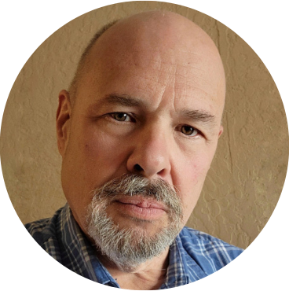
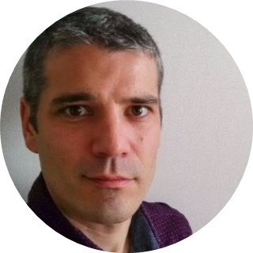
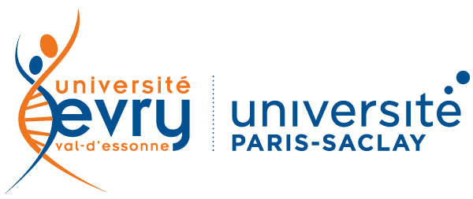
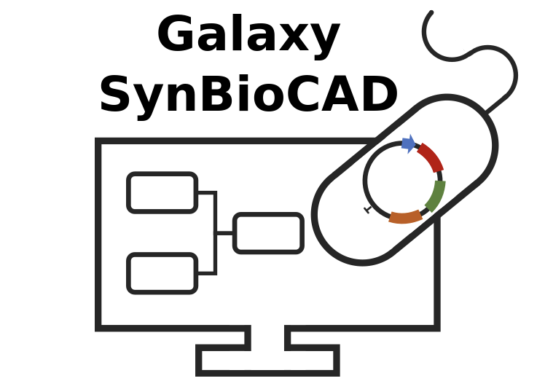
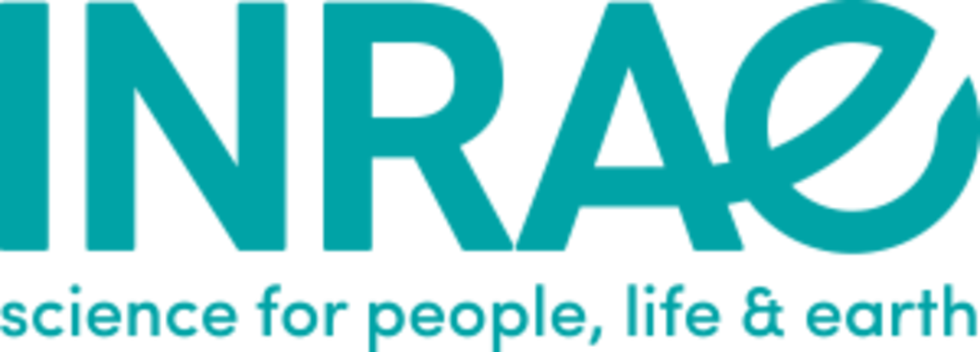
COFOUNDERS
COMPLEMENTARY TEAM OF INDUSTRY EXPERTS
30 yrs in biotech, pharma, software;
20 yrs as CEO & CTO;
12 yrs experience developing gas fermentation, carbon capture, synbio and biotransformation for climate tech
Founder @ NovoNutrients (foods & fine chemicals via CO2 capture.
Author of multiple issued patents in synthetic biology, gas fermentation, carbon capture and conversion, bioengineering.
Brian Sefton, MBA CEO
20 yrs in computational biology, bioinformatics, and synbio;
SynBioCAD technical creator;
Previously:
Deputy Director & Head of Synthetic Biology Labs @ Evry University.
10 Years as development and programming lead for multiple bioinformatics, AI/ML and bioengineering tools and applications
Joan Hérisson PhD. CTO
Pioneer with 30 yrs in synbio, AI and ML;
Global expert with +150 papers;
Senior Research Director @ INRAE;
Head of SynBio Master @ University of Paris-Saclay;
French Government Advisor for national bio-production strategy.
Jean-Loup Faulon PhD.

Slide 13
BRIAN SEFTON
Founder & CEO
bsefton@sirius.bio
sirius.bio

Slide 14
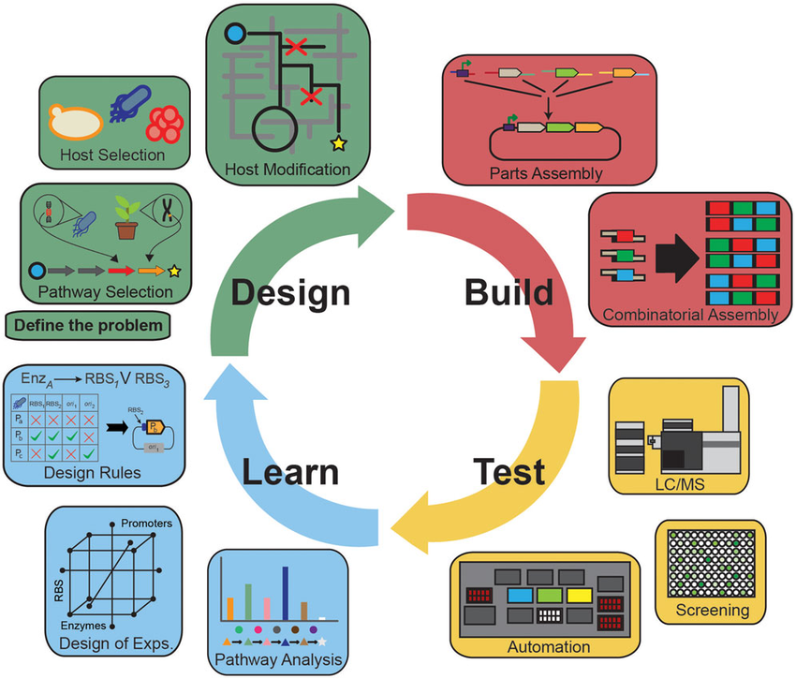
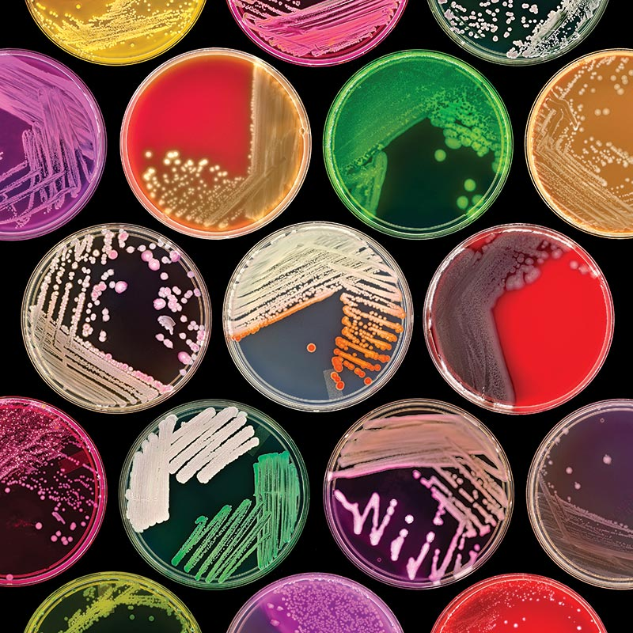
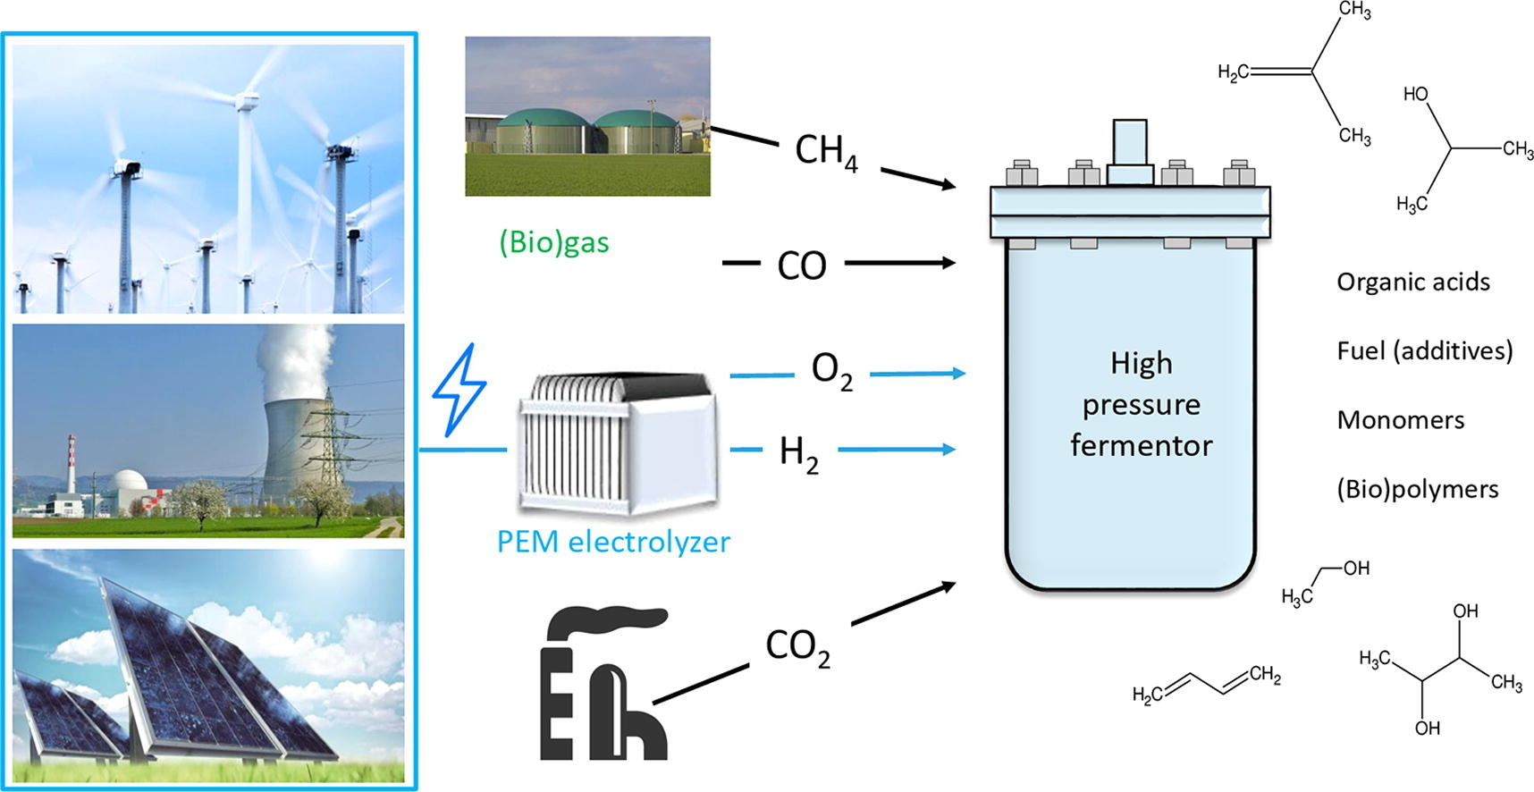
Key Technologies
Key Technologies
Sirius Founders are Domain Experts In All Key Technologies
High throughput DBTL Pipeline ML/AI
Bioinformatics
Automation
Synbio
Media optimization
System optimization
SBML and Metabolic network model creation
Bioprospecting
Smart sampling
C1 and other Metabolism Selecting
Fermentation
Gas Fermentation
High Throughput
Micro scale
Reactor design
Process Scale Up

Slide 15
PRODUCT: DBTL
BEM: A SIMPLIFIED LOOK
BioChemical
Reactions
Strain Models
AL
DoE
DNN
GNN
LMM
MCTS
Transformer
OUTPUT:
A library of
engineered
target-producing
strains
INPUT:
Strain
Target
BIOLOGICAL ENGINEERING MODEL (BEM)
SynBio literature
Molecular Biology protocols
Robot specs

Slide 16
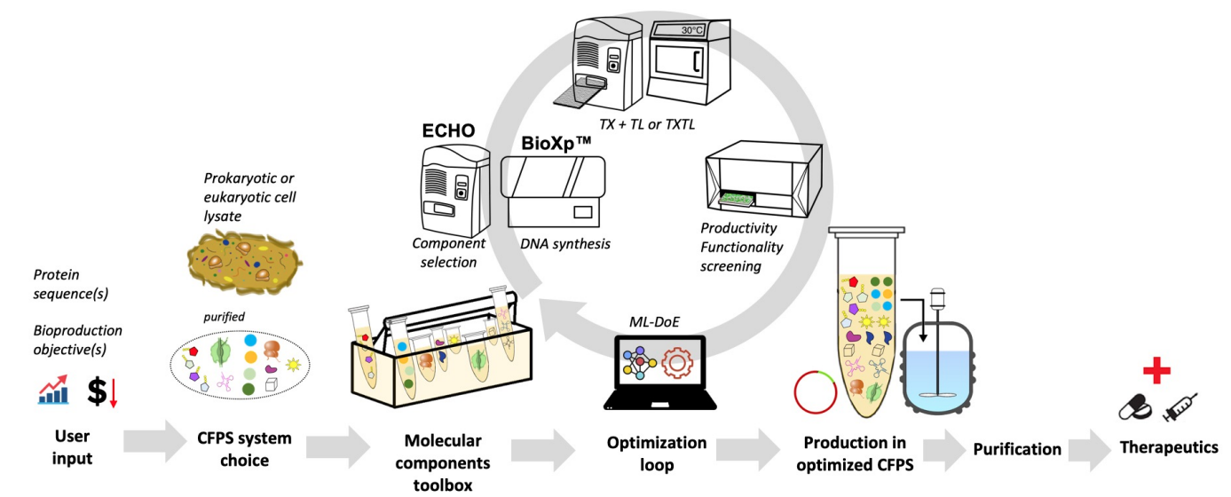
AI
OPTIMIZED SOLUTIONS VIA ML
1° round:
Initial configurations generated by Latin-Hypercube Sampling, tested at bench
ith round:
From round i-1 results, Active Learning gives
the best solution
the next configurations to test

Slide 17
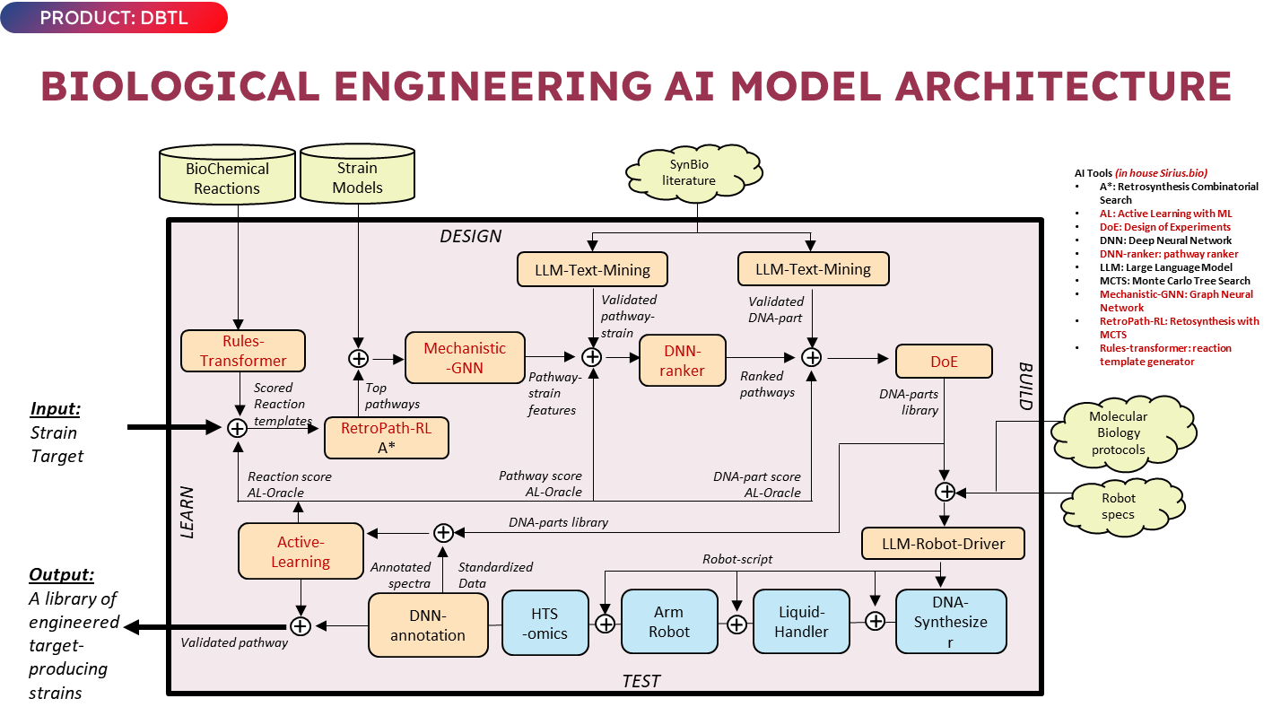

Slide 18
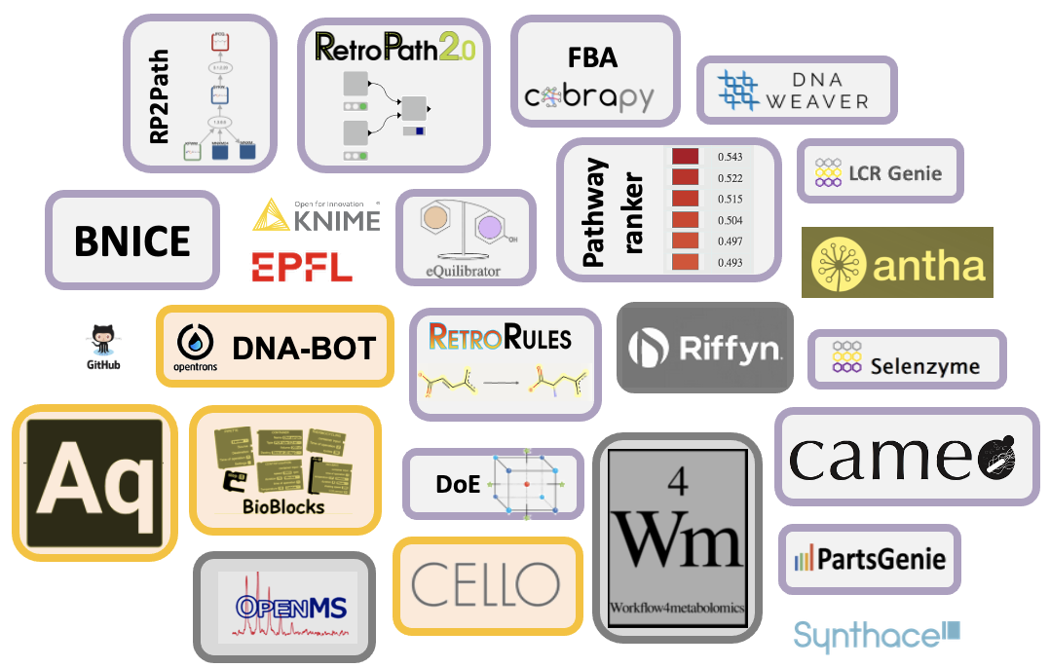
Our SynBioCAD and AI/ML infrastructure represent decades of work and >10M€ investment
SYNBIOCAD
QUICKER, CHEAPER, BETTER
Our SynBioCAD infrastructure is already delivering optimized bioproduction, biodegradation, biosensors, and cell-free systems in biofoundries
AUTOMATED DBTL = LOWER OPEX, CAPEX, TIME
for all biotechs: therapeutics, materials, chemicals, and foods.
ALL-IN-ONE = COMPLEXITY REMOVED
Tools consolidation & new features APIs for accelerated development, service expansion, and better customisation.
50X
required workflows reduction
❌
➡️
34X
target production increase

Slide 19
MICROBES
Non-model Strains: The Enzymes Enable the Feedstocks and Products
*Renewable hydrogen use creates a route from renewable electrical energy to food and chemical energy.
DiMe
Methane (CH4)
Methane Monooxygenase
CH4 + O2 CH3OH
Methanotrophic Bacteria
Grow with methane as sole carbon and energy source
DiMe
Hydrogenase
NiFe to capture CO2 and H2
CO2 + H2 CH2O
Carbon Dioxide (CO2) + H2
Hydrogen Bacteria
Grow off Hydrogen and CO2. *
Carbon Dioxide (CO2) + H2 or Light
DiMe
Hydrogenase
NiFe to capture CO2 and H2
CO2 + H2 CH2O
FeFe to make H2
CH2O H2 + CO2
Photosynthetic Hydrogen Bacteria
Grow off Hydrogen and CO2. *
Grow off sunlight and CO2
Can make Hydrogen from organics and sunlight

